Slide 1


Plant Phenotyping infrastructure: Breeding API & MIAPPE
From data standards to publication and data discovery in global databases federations
14 Jan 2018

Slide 2
Context

Slide 3
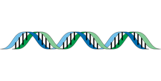
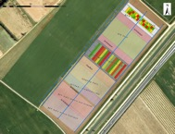
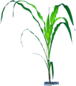
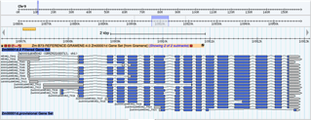
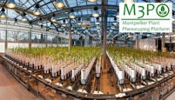


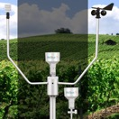
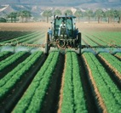
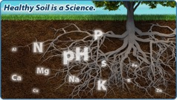
Genome / Environment / Phenome
Genetics & Genomics
Phenomics
Plant Breeding
Genetic variations by Traits
Homogenous (Mostly)
Central Access (Mostly)
Heterogenous
Distributed
Climate Change Studies
Genotype by Environment
Phenology
Environment

Slide 4
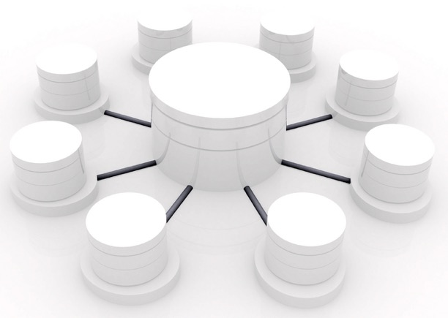
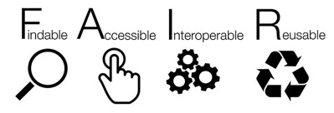
Federations of data repositories
A network of (stable/sustainable) nodes
A central portal offering services (e.g. search data)
A data standardisation
Backbone of good practices enabling such infrastructures
Nodes → Resources/Repository
Hub→ Portal Services access
Wilkinson et al (2016) SCIENTIFIC DATA, 3:160018, DOI: 10.1038/sdata.2016.18

Slide 5
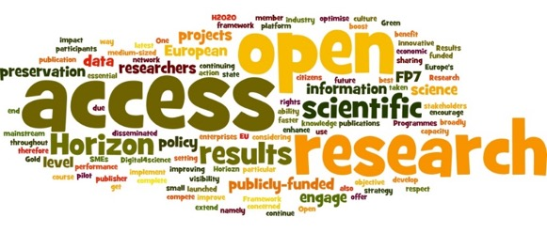

Europe open access and interoperability policy
“Facilitating access to results encourages the re-use of research outputs and supports Open Science. This is essential for Europe's ability to enhance its economic performance and improve the capacity to compete through knowledge. […] Results of publicly-funded research can therefore be disseminated more broadly and faster, to the benefit of researchers, innovative industry and citizens.
Recently funded projects were asked to add a WP supporting a FAIR compliant Data Management Plan

Slide 6
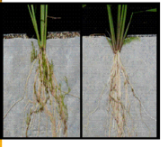
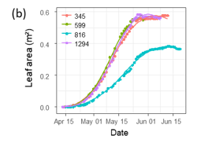
Phenotyping data life cycle
Raw data
Elaborated data
Soissons x high N
Charger x high N
Charger x low input
Soissons x high N
Charger x high N
Soissons x low input
Soissons x low input
Soissons x high N
Soissons x low input
Charger x low input
Charger x high N
Soissons x high N
Soissons x high N
Genotype | Treatment | N input | Date | Rep | Fusariose
Soissons | low input | 15,32253129 | 15/11/2011 | 1 | 5
Soissons | low input | 15,31430556 | 16/11/2011 | 2 | 7
Genotype | Treatment | Fusariose
Soissons | low input | 6

Slide 7
Plant Phenotyping Life cycle
Raw data long term conservation
Data acquisition
Traceability
Data computation
New computation for each scientific question
Data publication
One Data Publication by datasets.
Raw measures
Data Cleaning
Platform IS (Emphasis IS, PHIS, …)
One raw dataset → many computed datasets
Platform IS
FAIR Data Repositories
Reproducibility
Traceability
Provenance
Computed
Raw

Slide 8
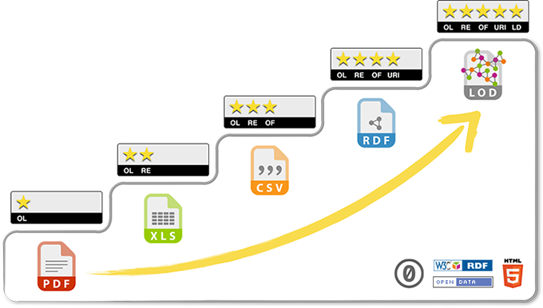
5 stars Open Data
related to other data
identified by URI
non-proprietary format
in a structured format
Data on the web, open licence
Bioinformaticians
Biologists
Progressing towards FAIR and Open Data requires a multidisciplinary cooperation :
Biologists
Bioinformaticians
specialists of ontologies/semantics

Slide 9




Challenges for phenomics data
FAIR data
Findable
Persistent identifier (ex: DOI)
Rich Indexed Metadata
Data portal
Accessible
Open data / DMP
Data portal
Interoperable
Web API
Linked data
Web semantics
Data formats
Reusable
Metadata standards
Licence / Publication
Documentation
Findable
Distributed model: no central phenomic data archive
Same or compatible ID and Metadata policy
Data portals
Accessible
Complex life cycle; different types of data : complex DMP
Interoperable
Compatible standards
Issues in relation with big data
Reusable
Phenotype = Genotype x Environment x Cultural practice => differents silos of metadata definition
Provenance is complex

Slide 10
Plant Data StandardS

Slide 11











Interoperability in International network
National
Networks
European
Networks
Global Networks
International data standards
Web services
Minimal information
Controlled vocabularies
Trait dictionaries
MCPD
Notes:
11

Slide 12
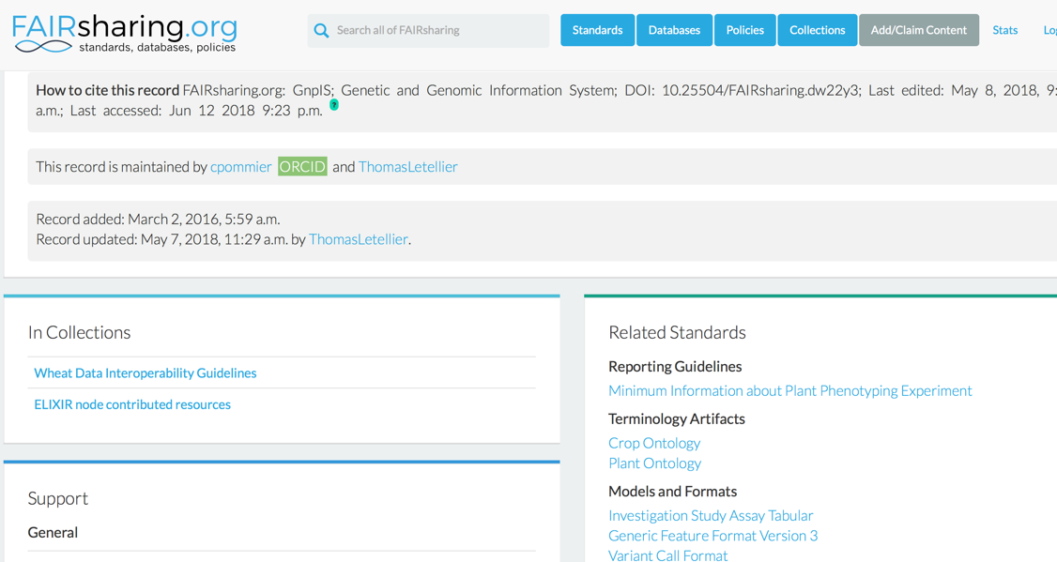
Sharing standards: standards registries

Slide 13
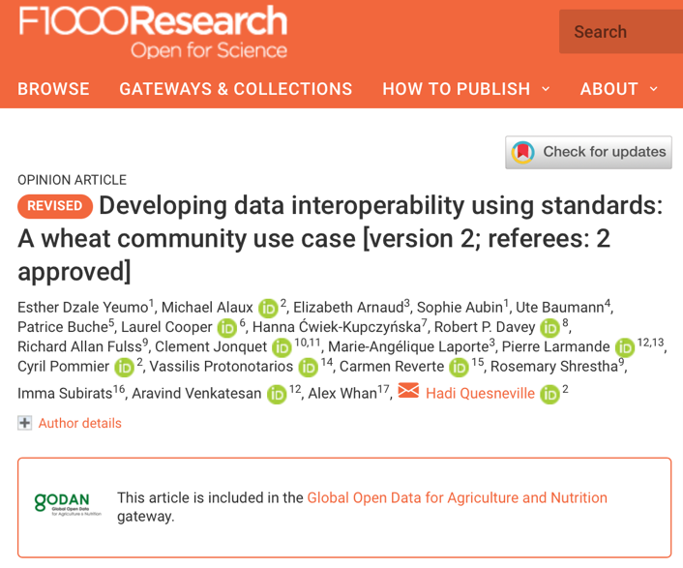
Community driven recomendations
WheatIS: http://wheatis.org/DataStandards.php
Published in F1000

Slide 14




Data standards for FAIR
Semantic
Description of the data
Controlled vocabularies: term name and definitions
Ontologies: semantic links between terms
Biologist driven
Structure
Formatting and Organizing the data
Data Models
Standards : CSV, VCF, GFF, MIAPPE (www.miappe.org) , etc…
Biologist & Computer scientist driven
Technical
Data integration and sharing
Interoperability : tools and systems
GA4GH
Breeding API www.brapi.org
Computer scientist driven

Slide 15



Phenotype Semantic Standard: Ontologies
Describing traits/features in specific plant species
Crop Ontology Trait + Method + Scale Semantic model
Woody Plant Ontology (ELIXIR-FR, ELIXIR-PT)
Maize Ontology
Brassica Trait Ontology (ELIXIR-FR, ELIXIR-UK)
Rice Ontology
Vitis Ontology
Wheat Ontology

Slide 16

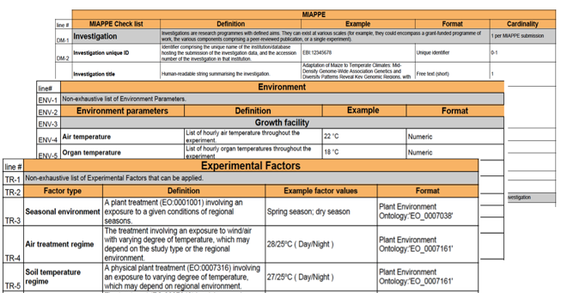
Phenotype Structure Standard
Minimal Information About Plant Phenotyping Experiment : version 1.1 (Jan 2019)
www.miappe.org
Many stakeholders
Elixir, Emphasis, Bioversity, North American PPN
Open Community:
Request for comments
Github Feature requests
Mailing lists
Meetings & Workgroups
Crops and woody plants

Slide 17

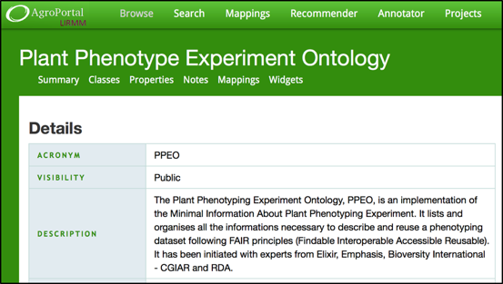




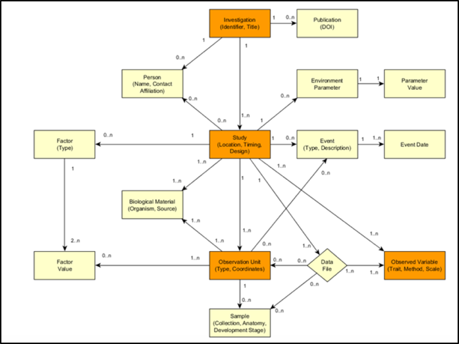
Phenotype Structure Standard
Computer scientist friendly :
Explicit Data Model: ISA-Tools and Breeding API (BrAPI) compatibility.
Validation framework and toolbox
Semantic representation in OWL: Phenotyping Experiment Ontology (PPEO) using OWL (http://agroportal.lirmm.fr/ontologies/PPEO )
Biologist friendly
Clear definitions and examples
Excel templates
Trainings
Specification with multiple implementations
File Archive: ISA Tab
Semantic: Plant Phenotyping Experiment Ontology
Web Service: Breeding API
Papoutsoglou et al. Enabling reusability and interoperability of plant phenotyping data (in preparation)

Slide 18
MIAPPE 1.1 Overview Dataset
Populus deltoïdes
INRA:73028-62
doi:10.15454/1.4921786081024297E12
Example: Monclus et al., 2012, [2]
Data file
Data file
Data file
Data file
6 randomized blocks
1 observation unit = one tree
No treatment
6 replicates defined by their position in each block: row and column

Slide 19
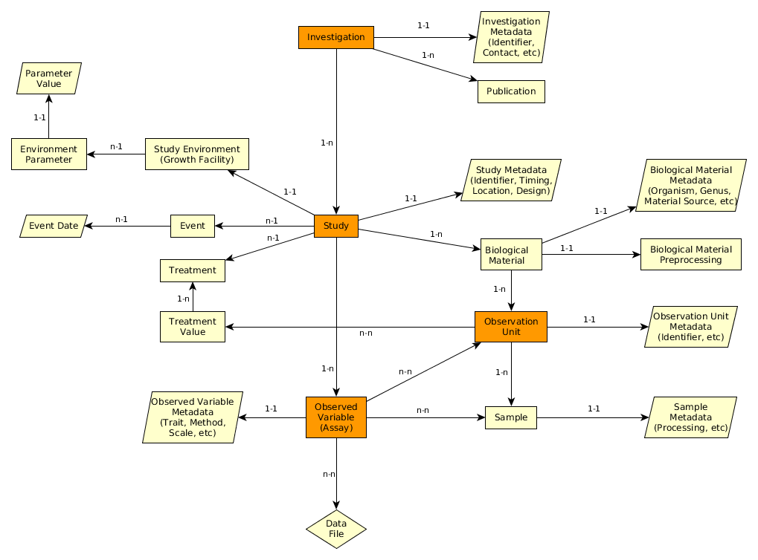
MIAPPE V1.1 Overview the (ISA) backbone
Investigation: whole dataset
Study : one experiment in one location for one to several year
Assay: Level + Trait + Method + Scale/Unit
Investigation
Study
Assay
(Observed variable)
Data file

Slide 20
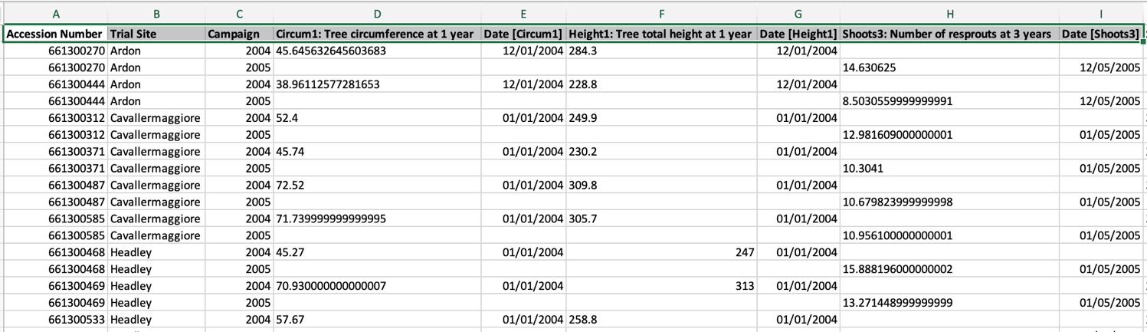
MIAPPE V1.1 Overview Data file content
Any format (Near Infra Red Spectrum, Images, Image Archives references, ….)
Mostly tabular
Metadata on each column header

Slide 21
MIAPPE v1.1 Metadata
Plant Material
Identification
Description
Multi Crop Passport Descriptor
Biological material
Observation Unit
Sample

Slide 22
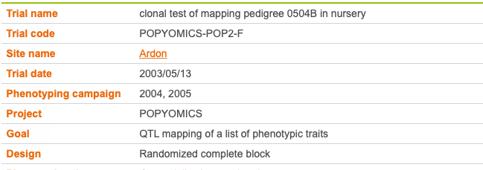
MIAPPE v1.1 Metadata
Study site, Year, Design, …
Study

Slide 23
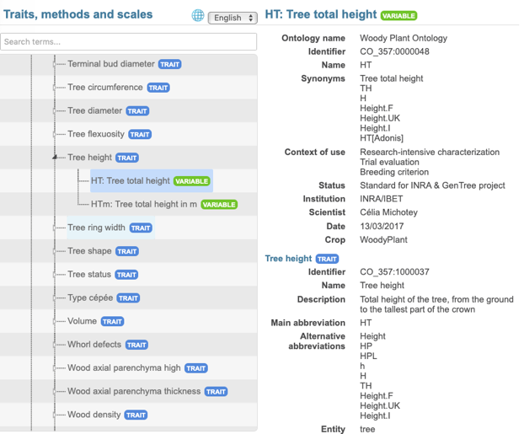
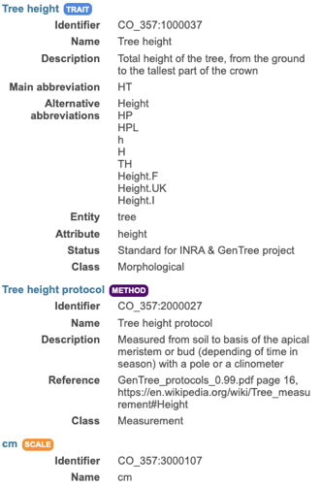
MIAPPE v1.1 Metadata
Observed Variable: Trait + Method + Scale
Assay
(Observed variable)

Slide 24









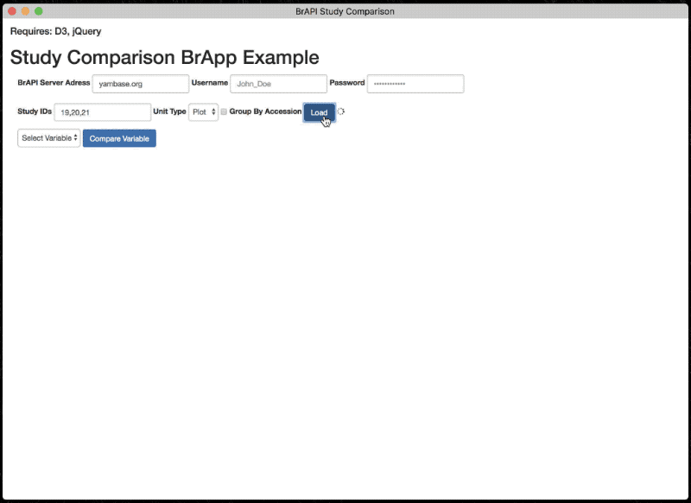
Phenotype Technical Standard
Breeding API http://brapi.org/
International collaboration
Standard Open Web Service API
Information Exchange, Main target: Breeding
Excellence in Breeding platform (CGIAR, Peter Selby)
Major Elixir Contribution
Phenotyping specification
Connect data repositories and tools:
Genotype visualization (Flapjack)
Studies graph preview and filtering
BrAPPS : Tools integrable in any BrAPI compliant System
https://www.brapi.org/brapps.php
R analysis environment
Field data capture
FAIR Data discovery → Elixir FAIDARE
T3
CIRAD
GOBII
Wageningen
Cornell
iPlant
Selby et al. Bioinformatics (2019),
doi.org/10.1093/bioinformatics/btz190

Slide 25





















Aknowledgment
Thank you!

